Slide 1


Industrial Cyber Security
linkedin.com/in/vibertprofile
Cevn@Vibertsolutions.com www.vibertsolutions.com 07909 992786

Slide 2
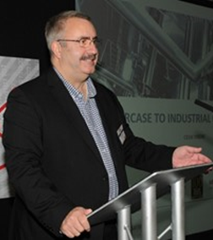
Vibert Solutions Ltd. - Cevn Vibert
Industrial Cyber Security Consultants and Advisors
Consultants, Solutions, Speakers, Trainers, Coaches
Our Teams advise companies in many countries and in most industry verticals.
Experienced in Security, Cyber, C2, MES, SCADA, Risk Managament, Governance, Compliance, Global Solutions, Industrial Networks, Solutions Consultancy and Training.
30+ yrs experience in Industrial Information and Control Systems.
Board Advisors. Directors. Chartered IT Professionals.
CITP, MIET, MISA, MISSA, MinstMC, MBCS
Build Communities
linkedin.com/in/vibertprofile
Cevn@Vibertsolutions.com www.vibertsolutions.com 07909 992786

Slide 3
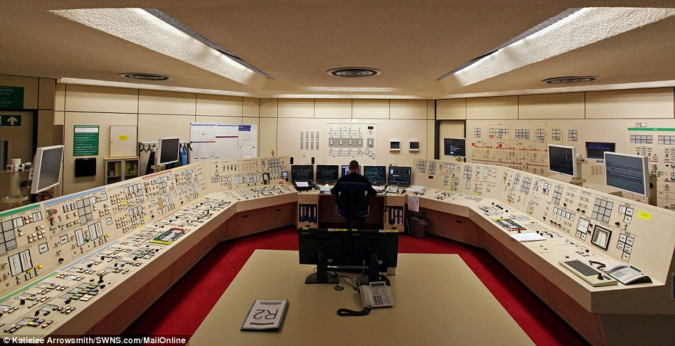
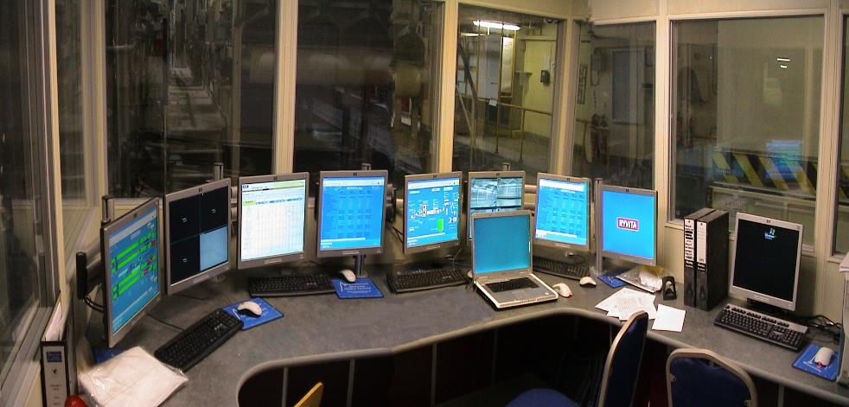

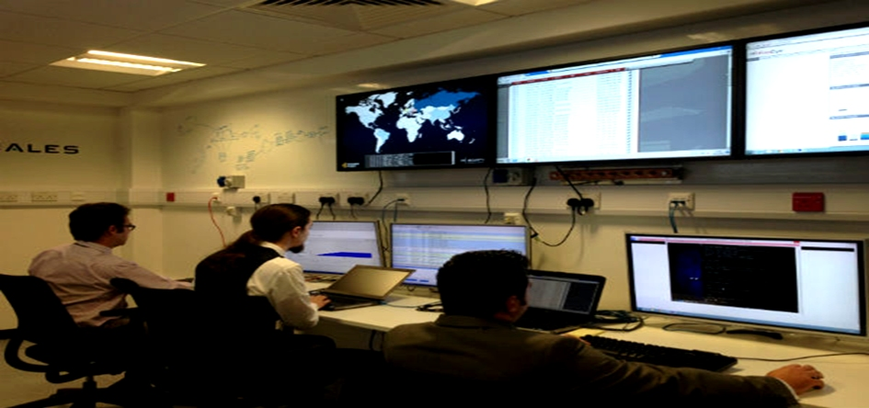
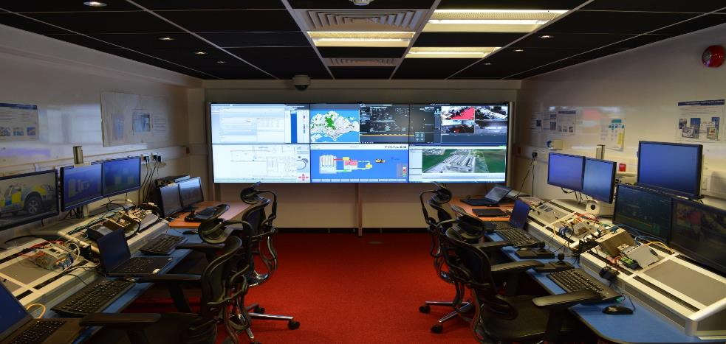
Nuclear
Manufacturing
Cyber
Security

Slide 4
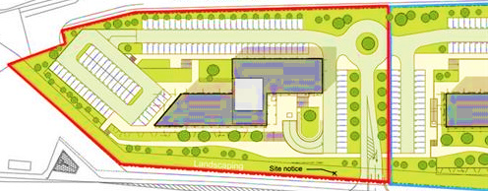
What IT, Computers, Networks should be Physically, Cyber and Operationally protected?
What “IT things” in a facility could be compromised?
Office Networks
CCTV Network
Office Backups
CCTV Cameras
Computer Server Room
Backup Power Supply Generators Room
Computer Server Room Fire Suppression Systems
UPS Backup Systems
PA Public Address System
Fire Detection and Alarm Systems
Access Control Network
Fire System Network
Card Reader and Biometrics devices
Building Management Systems
Security Control Room
Building Management Network
Reception Computer Terminals
HVAC Systems
Printers everywhere
Gate Control Systems
WiFi repeaters
Vehicle Stopper Control Systems
Door Control systems
Vending Machines and networks
TV on-demand networks

Slide 5

Security Strategy, Projects and Programmes
Is Security part of Business-as-Usual for the Board of Directors?
Remember – The Bad Guys don’t stop getting better – need Strategy…
How do you start to improve? – Security Staircase
What products, partners and vendors are useful? – Security Jigsaw
Who will make the improvements? – The Security A-Team

Slide 6
Cyber Security Capabilities
Surveys and Audits
Security Framework Developments
Risk Assessments
Compliance studies
Integrity and Access Controls
Anti-Malware
Incident Investigations
Intrusion Monitoring and Prevention (Local and Global Industrial SOCs)
Command and Control Management (ConOps)
Vulnerability Management – external links
Training and Briefings
Simulation and Strategizing
Maintenance and Controls
…….common sense strategies…..
Notes:
Please mind the size of text areas.

Slide 7
What’s your future… ?
How can you improve your security strategy?
Do you need help?
What are you going to do next?
We look forward to being on YOUR Security A-Team.
Cevn@Vibertsolutions.com www.vibertsolutions.com 07909 992786
linkedin.com/in/vibertprofile

Slide 8
Capabilities in Technology
Capabilities & Experience:
Extensive turn-key or ad-hoc capabilities in Technology Consultancy including IT & OT Technology Audits, Technical Requirements Capture, Design, Solutions, Implementation, Training, Support and Maintenance.
Fully encompassing capabilities in the design of communications, industrial OT and IT architectures, hands-on knowledge of a wide range of IT, Organisational and OT methodologies, creation of firewall rules, user and rule policy definitions and audits, call handling, documentation and full project life-cycles, change management, project and program management of IT and OT technology projects.
Cross-functional team technical and social collaboration is key to the success of diverse global programmes and our decades of experience will provide this success.
Our wide ranging Technical capabilities are developed after decades of work on Pharmaceutical, Nuclear, Oil & Gas, Manufacturing, UK and Foreign Government, Energy, Utilities, Transport, Water, CNI, Medical Devices, Telecoms and Financial facilities.

Slide 9
Capabilities in Automation
Capabilities & Experience:
Our extensive turn-key or ad-hoc capabilities in regulated Automation Consultancy including GAxP OT Automation asset and application Audits, Automation Requirements Capture, Automation Design, PLC/DCS/SCADA/IED/MES and Historians Solutions, links to ERP Solutions, full or collaborated Implementation, customised subject Training, and our comprehensive Support and Maintenance capabilities.
Our fully encompassing capabilities in a wide range of automation platforms and industrial cyber defence-in-depth protection and monitoring include OT and IT design of communications, industrial architectures, User Interfaces, and ConOps will be customised to each site’s scenarios.
Our hands-on knowledge of a wide range of IT, Organisational and OT international methodologies, reference architectures, segmentation, perimeter protection, asset and architecture inventories, documentation and full project life-cycles, change management, project and program management of IT and OT technology projects will be integrated with site and customer teams on each phase of work..
Multi-site migration planning, and integrating a cross-functional team for full technical and social collaboration is key to the success of diverse global programmes and our decades of experience will provide this success.
Our wide ranging Automation capabilities are developed after decades of work on Pharmaceutical, Nuclear, Oil & Gas, Manufacturing, UK and Foreign Government, Energy, Utilities, Transport, Water, CNI, Medical Devices, Telecoms and Financial facilities.

Slide 10
Capabilities in Quality, Risk & Compliance
Capabilities & Experience:
Our extensive turn-key or ad-hoc QRC leadership, assurance and implementation capabilities in regulated Automation Consultancy include GAxP compliance designs, QMS and technology in GAxP facilities.
Our capabilities include roles as Cyber Technical Leads including Global Standards Compliance and Audits, Risk Analysis and Management and Governance Document provision and will be integrated with each site and customer teams on each phase of work..
Our provision can include developing global frameworks, compliance matrices, audits, gap analysis, development of global Policies and Procedures and Operating Instructions, Risk Assessments and Mitigation/Remediation plans.
Our QRC capabilities include full Risk Monitoring and Risk Assessments of OT and IT systems, Training and staff development for a security culture, creation of security innovation teams and vendor capability/compliance assessments.
Our wide ranging QRC capabilities are developed after decades of work on Pharmaceutical, Nuclear, Oil & Gas, Manufacturing, UK and Foreign Government, Energy, Utilities, Transport, Water, CNI, Medical Devices, Telecoms and Financial facilities.

Slide 11
Industrial Cyber Security Enhancements - The Perfect Plan… (1)
Assist CISO to define an overall number of business. (Goals)
Agree Program of Projects to successfully achieve the aims. (The Staircase to success).
Create an A-Team core group including 3rd parties, senior Customer rep., nominated change leader from selected sites, etc. (Cross-Functional buy-in).
Create the core Framework with site representative full involvement (no surprises).
Carry out initial audit/assessments for each site with site involvement ( site understand the aims).
Create framework compliance and gap reports and any details of closure plans(The Now and the Future).
Assist with Risk Assessments to define Risk Gaps according to Impacts and Risk Appetite of CISO.
Review Gaps and Plans and re-work the aims/goals and the Program/Project to suit the business.
Rough design Cyber Security Improvement templates/Solutions with IT and OT Operations people.
Build initial designs for each element of the Solutions including 3rd party and internals (The Jigsaw).

Slide 12
Industrial Cyber Security Enhancements - The Perfect Plan? (2)
Security Designs to include Operation Sites, Management Sites and Local SOCS and Global SOCs.
Create Governance Policies and Procedures and OIs to meet the framework and best practices.
Ensure regular Design and Progress review with the A-Team. (No big bangs!)
Assist /Provide Training programs including the A-Team as backers. (Champions)
Re-run the audits/assessments for each site after primary gap filling is complete and report status.

Slide 13
Industrial Cyber Security Engagement Strategy (example)
Phase1: Initial Engagement Assistance Study:
Team work with Client to understand initial business goals or to help define them.
Team work to engage Customer’s wider team and to create a core A-Team going forward.
Team and CISO define and agree the scope of engagement and success criteria and rough plan of projects and program to achieve success.
A number of small Working Groups engage each of the chosen sites and understand the core architectures, vendors, systems and status of governance.
Define the projects and programmes to sufficient detail for any fixed price work.
Define the scope, governance and commercial/financial boundaries for the ongoing 6month/12month/Xmonth programs and budgets agreed for the ongoing assistance work.
Customer agrees any quotes and T&M budgets and places any orders needed.
Phase 2:
Team engaged for governance of the programme, also the evangelist, trumpet, enabler and steering group.
The coalesced group assists with or actions managing Vendors, Site’s activities, Corporate IT liaison, and carrying out all framework, assessment, audit, and design work. The Team can also carry out Training, Support, Compliance with other standards such as GDPR/NIS-Directive/ISO2700x, etc.

Slide 14


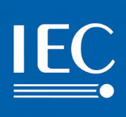



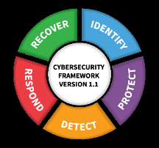

Business Benefits of Industrial Cyber Security
Increases performance – better visibility, faster responses, improves asset/operations management.
Achieve Compliance with International Standards = de-risks business operations.
Create standardisations – improves site migrations/coalescences/integration/comprehension.
Asset Management – improves documentation of assets, asset monitoring, asset efficiencies.
System Monitoring – Improves system availability, reduces impacts, system and licence documentation.
Governance – improves visibility of compliance, increases transparency and accountability.
Information – Better information informs better decision making.
Access Management – improves accountability and overall asset management and security defences.
Intrusion Monitoring – Increases visibility of intrusions, alarm and event conditions and reduces risks.
Securing the future – assists with Business Continuity, future expansions and adaptions.
Improves morale – better security is better business and safer business.
Health and Safety - Improving Security improves the integrity of safety systems, building management systems and physical security systems and more…
Vulnerability awareness – monitoring can provide extensive vulnerability awareness for the board.
Global standards recognise Cyber Security as being a cornerstone in corporate governance: ISO2700x, NIST CSF, BS31111, etc.

Slide 15
Industrial Cyber Security Experience – Vibert Solutions
Extensive Industrial Automation, Manufacturing Information and Execution, CIP, Compliance, Multisite/Global, Governance, Physical Security and Industrial Cyber Security Experience.
Worked on projects for most industries and verticals creating first MES system including senior management consulting projects.
Extensive growing testimonials from colleagues and customers in Food, Water, Nuclear, Nuclear Reprocessing, Energy, Transport, O&G, Pharmaceuticals, Chemicals, Cement, Rail, Medical Devices, etc. in UK and Overseas.
Widely known in Automation, MES, Industrial Cyber Security industries in UK and overseas. 14k+ LinkedIn contacts. Frequent Chair, Speaker and Panellist at Industry Events and Conferences. Institute Education Officer.

Slide 16

Ref 0x
Lifetime Enhancement – Nuclear Generation
Customer
Business Need
Client realised the need to improve lifetime capability on all their Nuclear generation plants. Client required our assistance to provide Technical Leadership for project including governance, liaisons and experience.
EDF Energy (UK Nuclear Fleet)
Our Solution
Business Benefit
Perform role of Industrial Project/Technical Lead.
Review and updates to lifetime enhancement Framework
Review and updates to the technical architectures.
Creation and updates to an Overall Design lifetime enhancement and documentation.
Creation and Updates to timelines and Schedules.
Global Vendor Liaisons as Customer Champion.
Process Technical Team Global Liaisons
IT and Project Teams Global Liaisons
Integration and co-operation across Vendors, Global sites and Departments
Integration of technologies and standardization for functional fit.
Standardized vendor compliance management across the organization
Demonstrate compliance to global industrial lifetime enhancement Framework.

Slide 17
Ref 01
Protecting the Process
Customer
Business Need
Client realised the need to improve Cyber Security on all their manufacturing plants. Client required our assistance to provide Technical Leadership for Cyber Security project including design, governance, liaisons and experience.
One of the world‘s leading Oil Chemical Companies
Our Solution
Business Benefit
Perform role of Industrial Cyber Technical Lead.
Review and updates to a global Cyber Security Framework
Review and updates to the Cyber Security technical architectures.
Creation and updates to an Overall global Cyber Security GSOC Design and documentation.
Creation and Updates to Go-Live Schedules.
Global Vendor Liaisons as Customer Champion.
Process Technical Team Global Liaisons
IT and Project Teams Global Liaisons
Project Lead stand-in provision
Design methodologies and Framework to NIST 80-153, IEC 62443 and ISO2700x.
Integration and co-operation across Vendors, Global sites and Departments
Integration of technologies and standardization for functional fit.
Standardized vendor compliance management across the organization
Demonstrate compliance to global industrial cyber Framework.

Slide 18
Ref 02
Governance of Security
Customer
Business Need
Client realised the need to improve Cyber Security on all their manufacturing plants. Client required our assistance to provide Technical Leadership for Cyber Security project including design, governance, liaisons and experience.
One of the world‘s leading Oil Chemical Companies
Our Solution
Business Benefit
Perform role of Industrial Cyber Technical Lead.
Assisting the client in developing policies and procedures and Operating Instructions in line with the global framework
Creation and updates to an Overall global Cyber Security GSOC Design and documentation.
Process Technical Team Global Liaisons
Governance compliance in accordance with NIST methodologies, IS2700x and IEC62443.
Standardized global policy and procedures compliance management across the organization
Opportunities for site variations to fit within global policy and procedures
Demonstrate compliance to global industrial cyber Framework.

Slide 19
Ref 03
Critical National Infrastructure Protection Facility
Customer
Business Need
Requirement was for a multi-faceted Demo, Training and Development Facility to assist the business to with their Critical National Infrastructure Protection programmes.
One of the world‘s leading CNI Prime Integrators
Our Solution
Business Benefit
Perform role of Industrial Cyber Subject Matter Expert
Perform role of Customer Engagement Manager.
Perform role of CNI Application Development Manager.
Creation and Management of a CNI Protection Facility.
Architected overall Facility.
Vendor Liaisons and Customer Liaisons.
Innovation Design projects.
Physical Security and Cyber Security
ICS, Automation, DCS, SCADA, Historians, etc.
Command and Control Systems.
Cyber Security, Forensics, Communications, Trust and multi-innovation led technologies.
Training and Development.
Customer Engagement Capability.
Business Development Opportunities.
System and Solution Demonstrations.
Sales and Marketing Aid.
System and Integration de-risking through trials and testing.
Project de-risking.
Exploration and discovery of innovative systems, applications and methods.
Internal and External Training Learning.

Slide 20
Ref 04
Reducing the Risks
Customer
Business Need
Client realised the need to improve Cyber Security on all their manufacturing plants. Client required our assistance to provide Technical Leadership for Cyber Security project including design, governance, liaisons and experience.
One of the world‘s leading Oil Chemical Companies
Our Solution
Business Benefit
Perform role of Industrial Cyber Technical Lead.
Creation and updates to an Overall global Cyber Security Risk Management Methodology.
Creation and updates to an Overall global Cyber Security Risk Management Tool.
Process Technical Team Global Liaisons.
Risk Methodologies to IEC62443, NIST and ANSSI.
Standardized Global Risk Management Methodology
Standardized Global Risk Management Tool
Standard Risk Records for future data mining.

Slide 21
Ref 05
Security through Compliance
Customer
Business Need
Client required Industrial Cyber Security applied to their Automation, SCADA and Telemetry Designs. Client required our assistance to provide Technical Authority including design, governance, solutioneering, experience and compliance.
One of the world‘s leading Pipeline Companies
Our Solution
Business Benefit
Perform role of Industrial Cyber Technical Design Authority.
Creation of an Industrial Cyber Security Risk Management Project Methodology.
Architected overall Cyber Security Project Plan.
Process Technical Team Liaisons.
End-Customer Technical Liaisons.
Compliance Methodologies to IEC62443, NIST and IS2700x.
Compliant risk management methodology
Compliant information management methodology
Compliant cyber security design approach.
Clarity of Cyber Project step-by-step execution.

Slide 22
Ref 06
Taming the Genie in the bottle
Customer
Business Need
Client required Industrial Cyber Security scalable and repeatable and standardized methodologies applied to their Automation, DCS, SCADA installations.
One of the world‘s leading Nuclear sites
Our Solution
Business Benefit
Perform role of Industrial Cyber Subject Matter Expert for 6month 20man programme.
Creation of an Industrial Cyber Security Risk Management Project Methodology.
Architected overall Cyber Security Project Plan.
Process Technical Team Liaisons.
End-Customer Technical Liaisons.
Compliance Methodologies to IEC62443, NIST, ANSSI, IS1, IRAM and IS2700x.
Accepted methodologies suitable for 100+ different systems of wide ranging ages.
Compliant risk assessment methodology
Compliant information management methodology

Slide 23
Ref 07
Critical National Infrastructure Protection Facility
Customer
Business Need
Requirement was for an independent Industrial Cyber Technical Adviser to survey the market, advise on tactical approaches, develop marcomms material and review product compliance to 62443.
Global Cyber Security Vendor
Our Solution
Business Benefit
Provide Industrial Cyber Consultancy.
Vendor Liaisons
Customer Technical Liaisons.
Product and Market Surveys.
Technical Assessments.
Technical Compliance Studies.
Provision of Market Material.
Market Trends Awareness
Product Impact Awareness
Sales benefits of standards compliance.
Market positioning awareness
Independent product review
Independent product comparisons.

Slide 24


Pharmaceutical Manufacturing
Ref 21
Operational Monitoring
Manufacturing
GSK Dartford
Solution
Technology Landscape
Value Delivered
Metrics
Operational Monitoring
Information Analysis and Design
Installation
Implementation
Testing
Resilient OPC Data Servers
AspenTech Products
OPC Servers
IP21
IPBatch
Batch Information
Instrumentation Information
Combined Batch and Process Reporting
Scientific Data Reports
Batch, Daily, Weekly Management Reports
Process Efficiency Reports
OT Systems Monitoring
Thousands of Process Data Points logged and batch reported.
Time-based combined-data reporting.
Multi-Batch overlay visibility.
OT Services in Regulated Industries

Slide 25

Pharmaceutical Manufacturing
Ref 22
Operational Monitoring
Manufacturing
GSK Worthing
Solution
Technology Landscape
Value Delivered
Metrics
Requirements Analysis
Operational Monitoring
Compliance Data and Reporting
Information Analysis and Design
Installation
Implementation
Testing
Wonderware Products
OPC and DDE Servers
InTouch SCADA
SQL Server
PACSCOM Radio SCADA Systems
Product Storage Information
Instrumentation Information
Validation Reporting
Scientific Data Reports
Daily Management Reports
Process Control Efficiency Reports
OT Systems Monitoring
Validation Data Storage
Critical Chemistry Facility Instrumentation Data Points logged and reported.
Time-based secure data reporting to 21CFRpt11 compliance.
Performance visibility.
OT Services in Regulated Industries

Slide 26

Medical Device Manufacturing
Ref 23
Operational Monitoring
Manufacturing
Contact Lens Manufacturer.
Solution
Technology Landscape
Value Delivered
Metrics
Consultancy
Requirements Analysis
Operational Monitoring
Compliance Data and Reporting
Information Analysis and Design
Installation
Training
Implementation
Program Management
Governance
Vendor Management
Testing
Automation Services
SCADA
MES
Wonderware Products
OPC and DDE Servers
InTouch SCADA
IndustrialSQL Historian
InTrack MES
SQL Server
Rockwell/Allen Bradley PLC Systems
Highly-Resilient Systems
Consultancy and Implementation Projects for several years
Process Information
Instrumentation Information
Operational Reporting
Network Management
Validation Reporting
Scientific Data Reports
Daily Management Reports
Process Control Efficiency Reports
OT Systems Monitoring
Validation Data Storage
Process Data Points logged and reported.
Time-based secure data reporting to 21CFRpt11 compliance.
Performance visibility.
1st InTrack MES in UK
Customer delighted
OT Services in Regulated Industries

Slide 27

FMCG and Chemical Manufacturing
Ref 24
Operational Monitoring
Manufacturing
Proctor and Gamble Dartford.
Solution
Technology Landscape
Value Delivered
Metrics
Consultancy
Requirements Analysis
Operational Monitoring
Compliance Data and Reporting
Information Analysis and Design
Installation
Implementation
Testing
Training
Project Management
SCADA
MES
Wonderware Products
OPC and DDE Servers
InTouch SCADA
SPC MES
SQL Server
Statistical Process Control
Consultancy and Implementation Projects for several years
Process Information
Instrumentation Information
Operational Reporting
Network Management
Validation Reporting
Scientific Data Reports
Daily Management Reports
Process Control Efficiency Reports
OT Systems Monitoring
Validation Data Storage
Process Data Points logged and reported.
Time-based secure data reporting to P&G Standards compliance.
Performance visibility.
1st SPC MES in UK
Customer delighted
OT Services in Regulated Industries

Slide 28

Food Manufacturing
Ref 25
Operational Monitoring
Manufacturing
Ginsters - Cornwall.
Solution
Technology Landscape
Value Delivered
Metrics
Consultancy
Requirements Analysis
Operational Monitoring
Compliance Data and Reporting
Information Analysis and Design
Installation
Implementation
Testing
Training
Project Management
SCADA
MES
Wonderware Products
OPC and DDE Servers
InTouch SCADA
IndustrialSQL Historian
SQL Server
WebReporting Services
Consultancy and Implementation
Process Information
Instrumentation Information
Operational Reporting
Network Management
Validation Reporting
Scientific Data Reports
Daily Management Reports
Process Control Efficiency Reports
OT Systems Monitoring
Validation Data Storage
Process Data Points logged and reported.
Time-based secure data reporting for audit compliance.
Performance visibility.
Customer delighted
OT Services in Regulated Industries

Slide 29

Food Manufacturing
Ref 26
Operational Monitoring
Manufacturing
Ryvita - Poole.
Solution
Technology Landscape
Value Delivered
Metrics
Consultancy
Requirements Analysis
Operational Monitoring
Compliance Data and Reporting
Information Analysis and Design
Installation
Implementation
Testing
Training
Project Management
Convert 40Mb xls into MES
SCADA
MES
Wonderware Products
OPC and DDE Servers
InTouch SCADA
IndustrialSQL Historian
SQL Server
WebReporting Services
Consultancy and Implementation projects over several years
Process Information
Instrumentation Information
Operational Reporting
Network Management
Validation Reporting
Scientific Data Reports
Daily Management Reports
Process Control Efficiency Reports
OT Systems Monitoring
Validation Data Storage
90% reduction in manual inputs
Improvements in efficiency, accuracy, transparency and reporting
Process and Operational Data Points logged and reported.
Time-based secure data reporting for audit compliance.
1st Citect Ampla MES in UK
Performance visibility.
Customer delighted
OT Services in Regulated Industries

Slide 30
Sample resource profile 1
During the last 20 years this resource has worked across a wide Cyber Security spectrum; including, UK Government, Foreign Government, Critical National Infrastructure, Physical Security, Space, Aviation, Utilities, Manufacturing, Nuclear and Research.
This resource has also been employed in a variety of roles including Cyber Security Subject Matter Expert (SME), Cyber Lead, Head of Security, UK CLAS Consultant, Security Engineer, Information Assurance Lead, IT Security Officer and Auditor.
This resource is an experienced Cyber security professional who is a former UK Government Security and Intelligence Advisor who is well respected in the Cyber Security field. This resource has authored many papers on behalf of the UK Government in respect of the Critical National Infrastructure.
This resource has extensive experience in dealing on a personal nature with agencies including commercial, public, local and national and foreign government.
This resource is well versed in all communications mediums, including satellite and radio, data networks and processor-controlled systems over protected networks and service orientated architectures. This resource has extensive theoretical and practical knowledge on Computer Security, TEMPEST, Information Technology, Communications Security, Key Management, Data Protection, FOI, RIPA, PCI DSS, ISO27001/2, Security Policy Framework, JSP440, NIST, ISF, SANS, IEC62443 Suite, NIS, Risk Assessment and other legislative requirements including commercial and international.
This resource is an expert in the field of whole life Information Assurance (from requirements through to support; covering design, security testing, integration and delivery), security stakeholder management and the evaluation and accreditation of security products and systems.
This resource is well versed in all areas of Cyber security and the application of practical and relevant security to align with specific business and stakeholder risks and requirements within the corporate, enterprise, consortium and system / product environment.

Slide 31
Sample resource profile 2
During the last 18 years this resource has been fortunate to have worked across a wide spectrum of industries including, UK Government, Foreign Government, Financial Services, Utilities, Nuclear, Critical National Infrastructure, Safety, Travel and Hospitality, Telecommunications, Manufacturing, Rail, Healthcare, Higher Educational Sector and Research & Development.
This resource has also has been employed in a variety of roles including but not limited to Risk Management and Compliance SME, Data Modelling Expert, Cyber Business and Digital Transformation Expert, Cyber Business and Technical Change Manager, COTS products and implementation SME, Procurement Analyst, Cyber Business and Technical Requirements Analyst, Process Re-engineering SME, GDPR Expert, PCI-DSS Expert, Business Insights and Analytics SME Programme and Project Manager including Cyber, Governance Expert, Organisational design and change SME.
This resource has extensive experience in dealing on a personal nature with agencies including commercial, public, local and national and foreign government.
This resource has excellent theoretical and practical knowledge in Prince 2, Agile, Six Sigma, Microsoft BI, ISO 27001, SDLC frameworks and other legislative and International Standards.
This resource has a successful track record of delivering and implementing technical and business programmes Finance, Finance Reporting and Analytics, Risk management frameworks and multi-IT projects and developed ideas into practical solutions. This resource is excellent at quickly re-prioritizing in a climate of changing priorities, work volumes and resources and has proven ability to develop and maintain exceptional client engagement and business relationships.

Slide 32
Sample resource profile 3
During the last 10 years this resource has been fortunate to have worked across range of industries including Critical National Infrastructure, Utilities, Research and Development, Manufacturing and Telecommunications.
This resource has also been employed in a variety of roles related to Cyber, including but not limited to Solution Design and Enterprise Architect, Product and System Architect, System Integrator, Risk Management and Compliance Expert, System Engineer, Digital Transformation Expert, Network Inventory Management (NIM) and Service Fulfilment Expert, Operation Support System (OSS) SME, Wireframing SME Process Modelling and Methodologies SME Cloud Computing, SME Unit and Functional Testing SME PCI DSS expert, COTS Products expert and System Component Developer.
This resource has global certifications on TM Business Process Framework, TM Forum Information Framework, Technical Certified Professional-IP, TOGAF 9.1, NIIT, CC and C Solutions.
This resource has superior skills and expertise in all areas of Enterprise and Solution Architecture and the implementation of the design in line with the requirements from stakeholders within the corporate, enterprise, consortium and system / product environment.

